Slide 1
Pulsar Star Classification
Introduction to Machine Learning Final Project Presentation.
Aline Hubard Escalera

Slide 2
Pulsar Stars
Pulsars are neutron stars that look like flickering stars from earth. They radiate two beams of steady light in opposite directions, but because they are rotating the light that gets to earth looks flickering.
Pulsars have several applications in science and astronomy, so its useful to be able to easily identify them from the High Time Resolution Universe Survey.
Data set has 8 features and the target class indicating if the data comes from a pulsar.
Use the features to predict the class, a Classification problem.

Slide 3
Data Exploration and Scaling.
8 Features and a target class.
12528 instances or data points.
Imbalanced data as only 9% has target class 1 or as a pulsar.
Three features have some missing values.
Notes:
Data was scaled using max min, so all the features would be between 0 and 1 as some Classificators need the data scaled to do a better job. This scaling doesn’t change the correlation between the data.

Slide 4
Features Correlation
Notes:
Feature with the highest correlation to the target class has almost 15% of data missing.

Slide 5
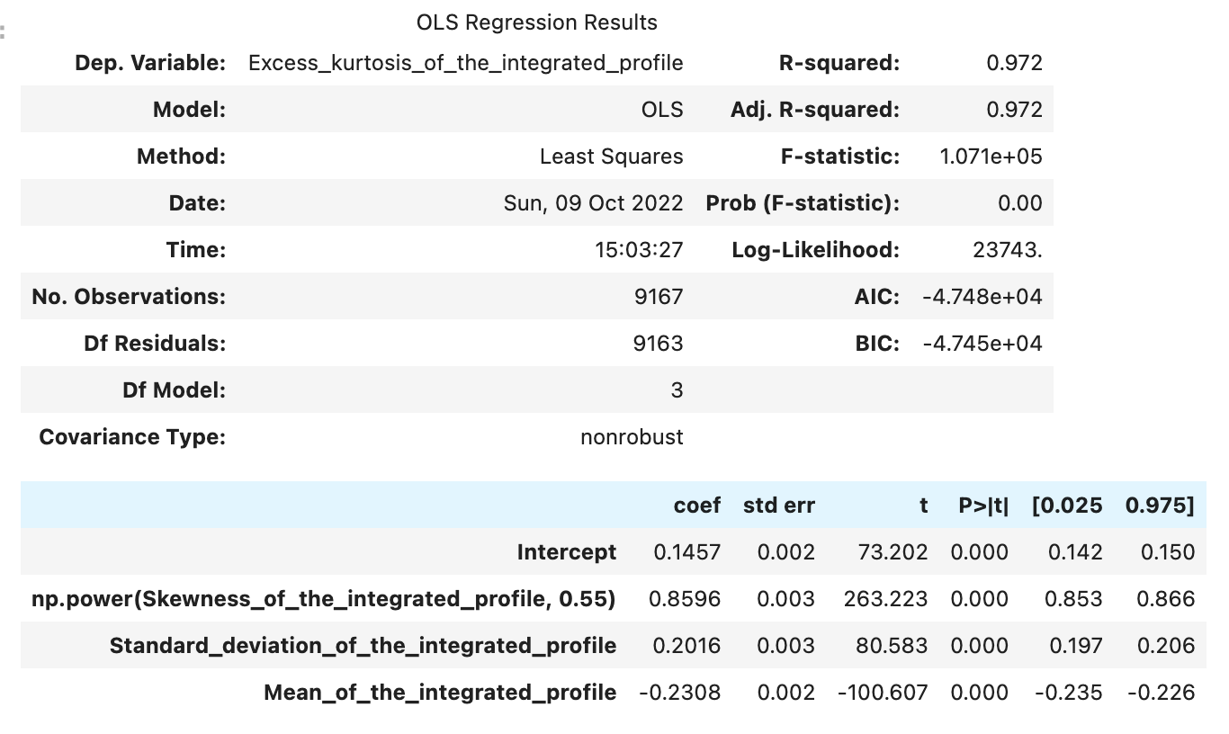
Linear Regression to get missing values of Feature.
Adj. R-Squared Test Data = 0.971

Slide 6
Seven Machine Learning Classificators.
Logistic Regression
KNN. Search over the number of neighbors to get the best F1 metric.
Decision Tree Classifier with search over alpha to prune and get best F1 metric.
Random Forest. With max depth of each forest = 2.
Extra Tree, similar to Random Forest but splits at random instead of optimizing like Random forest.
AdaBoost.
Linear Support Vector with gridsearch over the hyperparameter C.

Slide 7
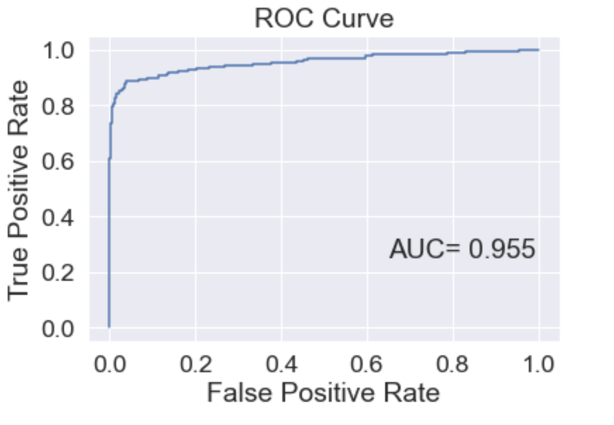
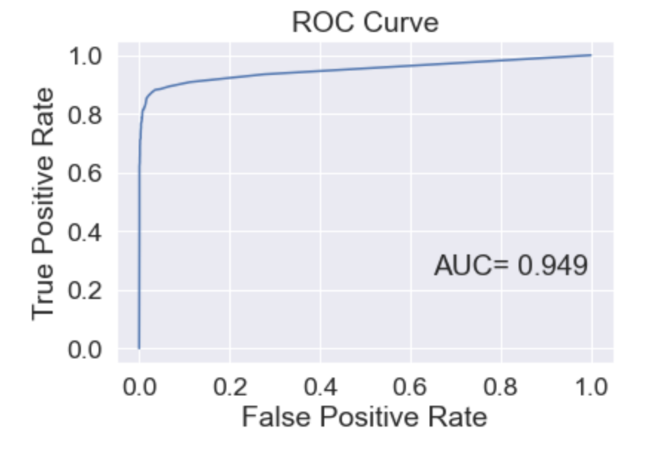
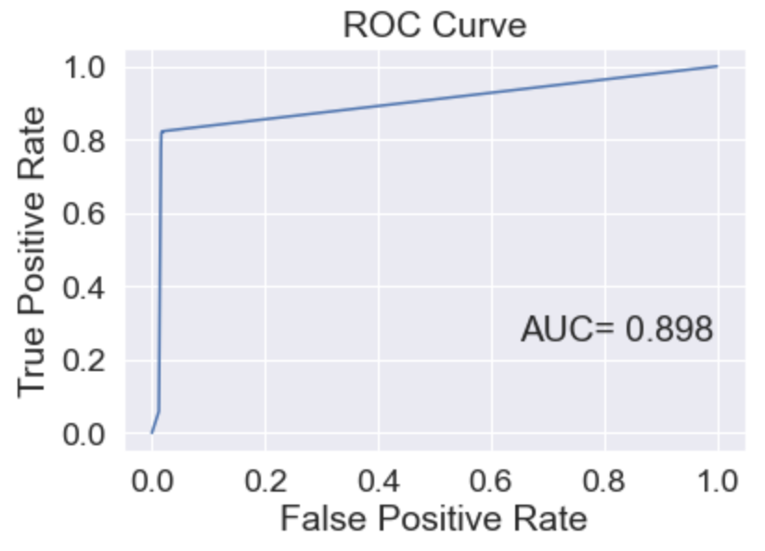
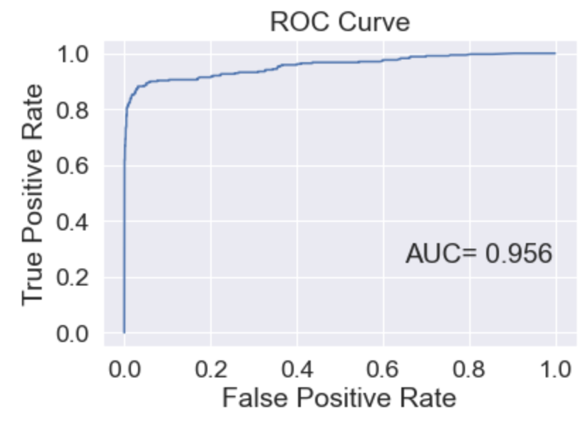
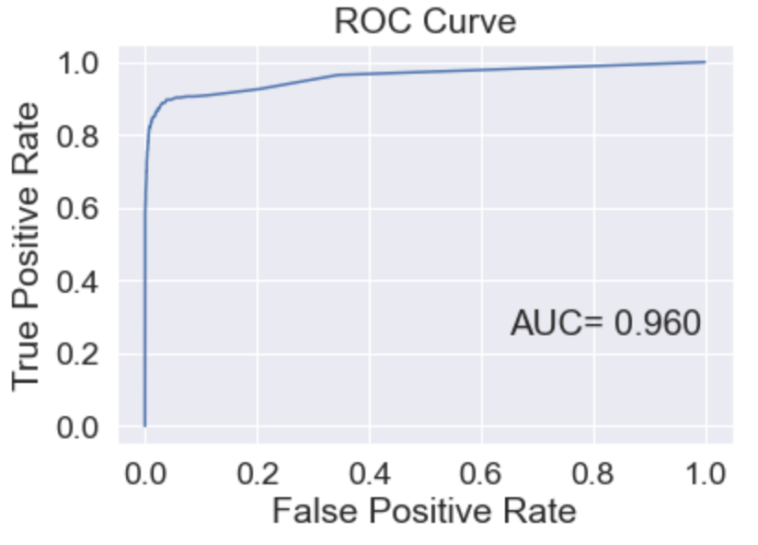
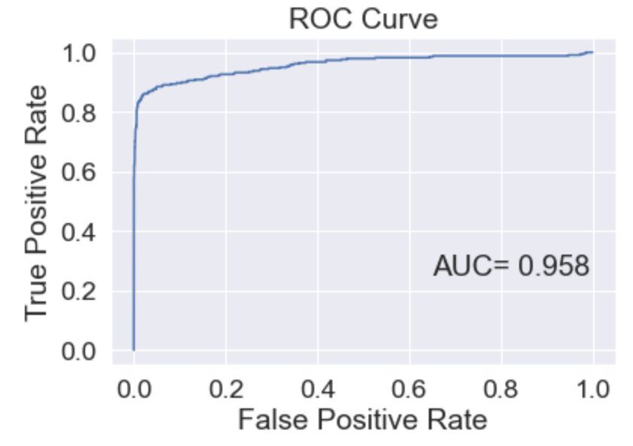
ROC Curves for Probabilistic Classifiers.
Logistic Regression
KNN
Decision Tree
Random Forest
Extra Tree
AdaBoost

Slide 8
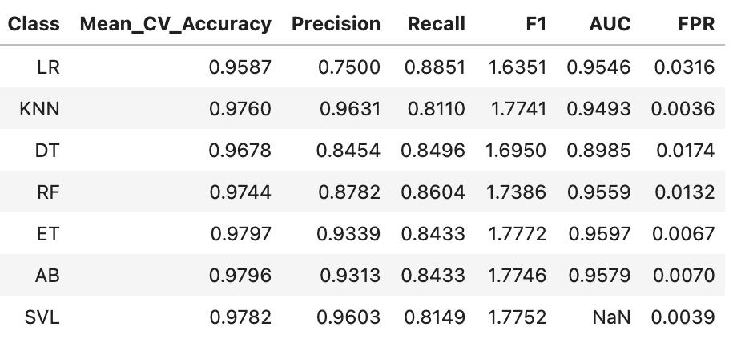
Evaluation metrics comparison.

Slide 9
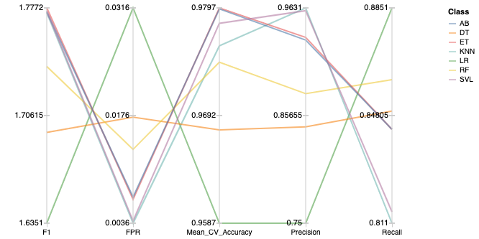
Evaluation metrics comparison.

Slide 10
Conclusions
All classificators did a good job predicting the target class.
The choice of classificator depends on what evaluation metric we care about the most.

